Slide 1
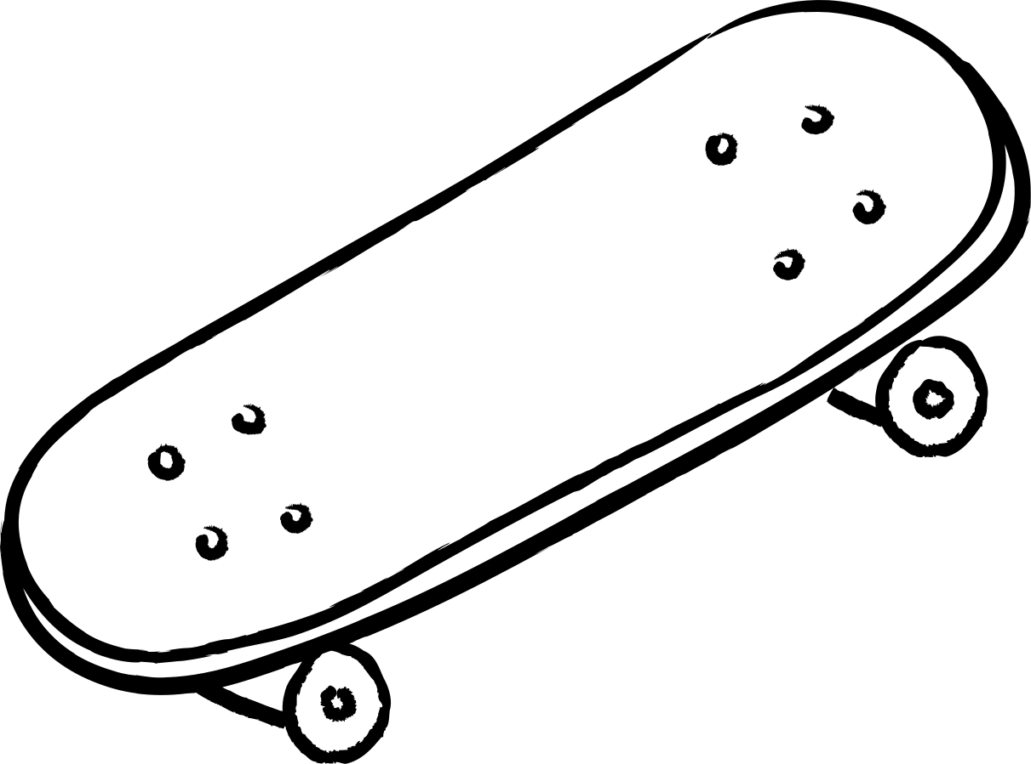
GROUP 403
CIS515 Final Project
E-Scooter/Vehicles Compliance System
Presented by
Vijay Kumar Devalla
Min-Yun Lai
Upmanyu Tyagi
Blair Chang
Rui Li

Slide 2

GROUP 403
CIS515 Final Project
Content
Introduction: Problem Definition
Introduction: Why is this problem important
End-to-End Solutions
Data Source
CV Model

Slide 3
Problem/Opportunity Definition
Introduction
Let’s Improve ASU Walk-Only Zone
The Arizona State University (ASU) community is committed to ensuring safety and promoting a pedestrian-friendly environment. The established Walk-Only Zones are instrumental in this effort. However, compliance with these zones has been challenging, particularly with the advent of e-scooters, skateboards and bikes. Instances of the riders violating the designated walk-only times have posed a risk to pedestrian safety and disrupted the intended tranquility of these zones. The opportunity lies in enhancing compliance through technological enforcement, thereby safeguarding pedestrians and preserving the integrity of Walk-Only Zones

Slide 4
Why is this problem important
Introduction
Addressing this issue is critical for several reasons. Firstly, safety is a paramount concern – e-scooters, skateboards and bikes can cause accidents, potentially resulting in injuries to pedestrians. Secondly, non-compliance undermines the purpose of Walk-Only Zones, designed to provide a secure and peaceful walking space free from vehicular disruptions. Lastly, ensuring adherence reflects the university’s commitment to rules and regulations, which is essential for maintaining order and discipline within the campus community
Stakeholders
ASU
Administration
Campus
Safety Staff
ASU Students, Faculty
Interested in policy adherence and campus safety
Responsible for enforcement of rules
Regular users of the walkways, desiring a safe campus

Slide 5
End-to-End Solutions
Solution Lifecycle Steps
Requirement Analysis and Planning
2. System Design
Set up YOLO, a object detection model, with pre-defined configurations and weight paths.
Use YOLO model to detect objects like persons, bicycles, e-scooters and skateboards in images.
Predicts whether these image patches contain e-scooters
Final images are saved to the specified output directory, ensuring all processed results are stored and accessible for later use
Identify specific Walk-Only Zone areas and times where compliance is an issue.
Define vehicles for a CV system capable of identifying e-scooters, bikes, and skateboards
3. Implementation (Development and Training)
4. Integration and Testing
5. Deployment
Install cameras and sensors in strategic locations within Walk-Only Zones.
Train the machine learning model using the provided datasets, focusing on accurate detection of e-scooters, bikes, and skateboards
Integrate the CV system with the campus network and test real-time detection capabilities.
Validate the system’s accuracy and efficiency in identifying non-compliant riders
Fully deploy the CV system in the designated zones.
Ensure the system is operational during the restricted times and capable of real-time processing.

Slide 6
End-to-End Solutions
Value of the Solution:
Enhanced pedestrian safety.
Preservation of Walk-Only Zone integrity.
Increased efficiency in enforcement with reduced reliance on manual monitoring.
Data-driven insights into compliance patterns. Estimation of these values would involve assessing current accident rates, non-compliance incidents, and the cost of manual enforcement against the projected reduction in accidents and rule violations, as well as the cost of implementing and running the technological solution.
Success Metrics:
Reduction in the number of non-compliance incidents.
Decrease in reported accidents or near misses.
Satisfaction levels of the campus community regarding safety.

Slide 7
End-to-End Solutions
Resources and Costs:
People: Technicians for installation, data scientists for model training, IT staff for maintenance.
Data: Access to current datasets, ongoing data collection for model retraining.
Systems: Cameras, servers, software licenses, notification system.
Computational Resources: Cloud services for data storage and processing, computational power for model training and inference.
Costs: Initial setup costs (hardware, software, labor) and ongoing operational costs (maintenance, updates, cloud services).
Workflow Updates/Costs:
People: Training for safety staff on the new system.
Process: Integration of alerts into existing safety protocols.
Technology: Upgrades to campus network infrastructure if necessary

Slide 8
End-to-End Solutions
Privacy and Security Issues:
Data privacy: Implement strict access controls and compliance with data protection laws.
Security: Employ robust encryption and cybersecurity measures to protect data
Scalability of the Solution:
Scope: Extend to other areas on campus or other campuses.
Domains: Adapt for use in other settings where policy enforcement is critical.
Scenarios: Modify to detect other types of violations or to serve in different environments (e.g., parking enforcement

Slide 9
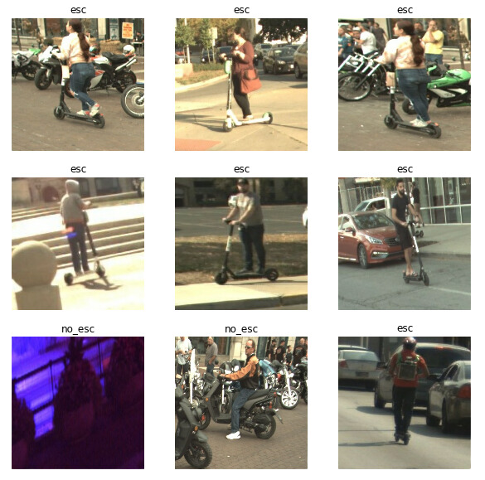
Data Source
Download images containing annotations for the specified classes ("skateboard", "bicycle", "person")
E-scooter riders:
https://universe.roboflow.com/antriv/patinetes-electricos
Bike riders:
https://universe.roboflow.com/jotaehyeong/test3-oo7ie
Skateboards:
https://www.gettyimages.com/photos/skateboard-profile

Slide 10
Computer Vision (CV) model
Part of the Solution Using CV:
CV is used for the real-time detection of e-scooters, bikes, and skateboards within the designated Walk-Only Zones to enforce compliance during restricted times.
Necessity of CV:
CV is required because the solution aims to automate the monitoring process for efficiency and accuracy, which is not feasible with manual monitoring.
CV Model Selection and References:
The proposed CV solution for ASU incorporates YOLO, a fast and accurate object detection algorithm, paired with MobileNetV2, which serves as a lightweight yet powerful feature extractor designed for mobile use. This combination ensures rapid and precise detection suitable for the real-time needs of monitoring ASU’s Walk-Only Zones. Leveraging MobileNetV2’s ImageNet training enhances the system's object recognition capabilities. For practical implementation, the model can be fine-tuned with ASU-specific datasets to ensure robust performance in the campus setting. Resources for development and refinement are sourced from extensive open-source documentation and versions available on platforms like GitHub, as well as academic research shared on arXiv and Papers with Code

Slide 11
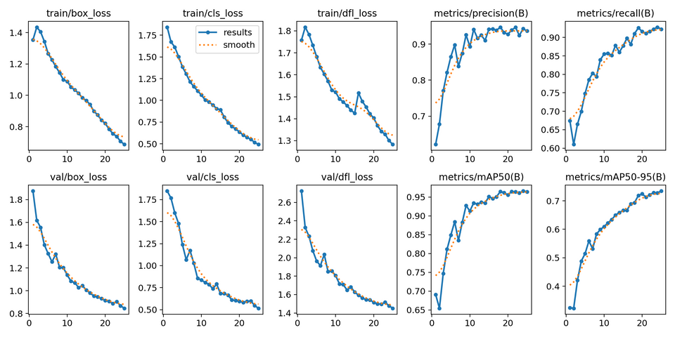
Computer Vision (CV) model
Evaluation Metrics: Loss, Precision, Recall and MAP.
Although we can see precision, recall and MAP50 settling a bit towards the end but from the box loss and class loss graphs we can conclude that the models can be further fine tuned with simply running more iterations.

Slide 12
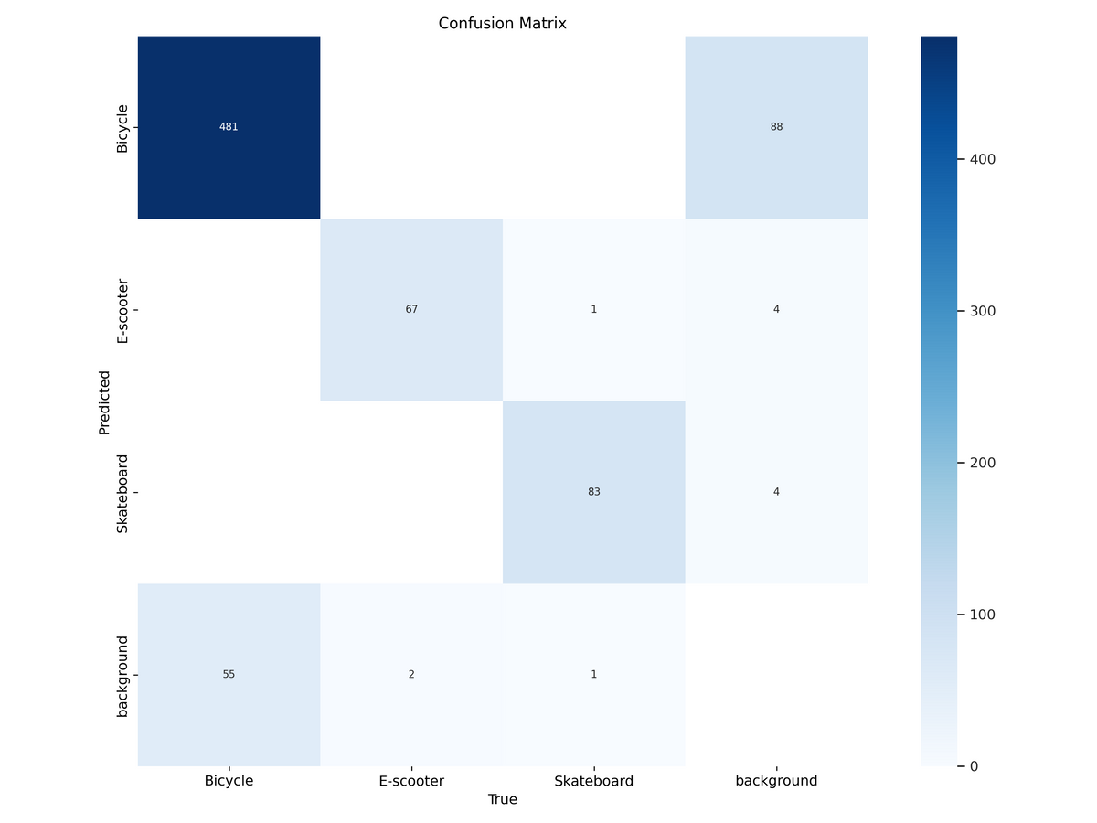
YOLO V8 model - Model Evaluation
Confusion Matrix:
The model is a bit skewed as the datasets for bicycles, e-scooters and skateboards are not equally distributed. From the confusion matrix we can conclude the following:
Bicycles are predicted correctly 481 times and the background has been mistook for a cycle 55 times.
E-Scooters are correctly spotted 67 times and the background has been identified as an E-Scooter 2 times.
Skateboards have been identified correctly 83 times. Although in 1 instance a skateboard has been identified as an E-Scooter and in another as a background.

Slide 13
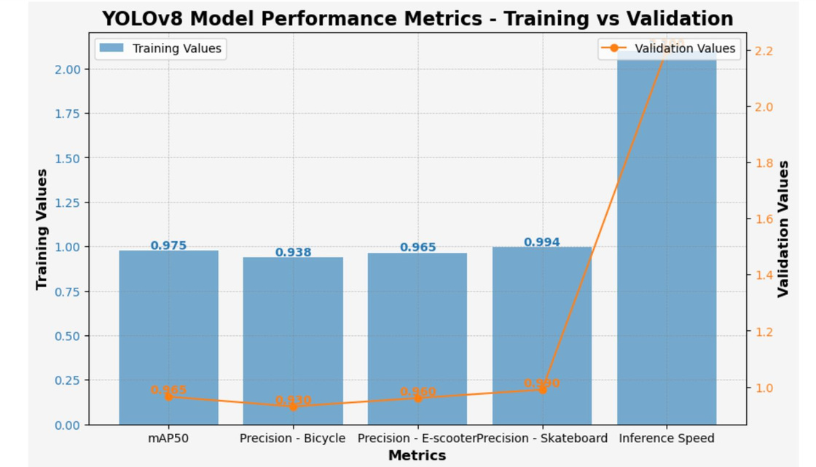
YOLO V8 model - Model Training & Validation Metric
High mean Average Precision (mAP50) during training, at 0.975.
Precision for bicycles, e-scooters, and skateboards during training at 0.938, 0.965, and 0.994 respectively.
Validation precision slightly lower for bicycles (0.930) and e-scooters (0.960), but comparable for skateboards.
Inference speed (validation value) significantly higher, indicating a trade-off between precision and speed.
Consistent performance across object classes, with skateboards being the most accurately detected.

Slide 14
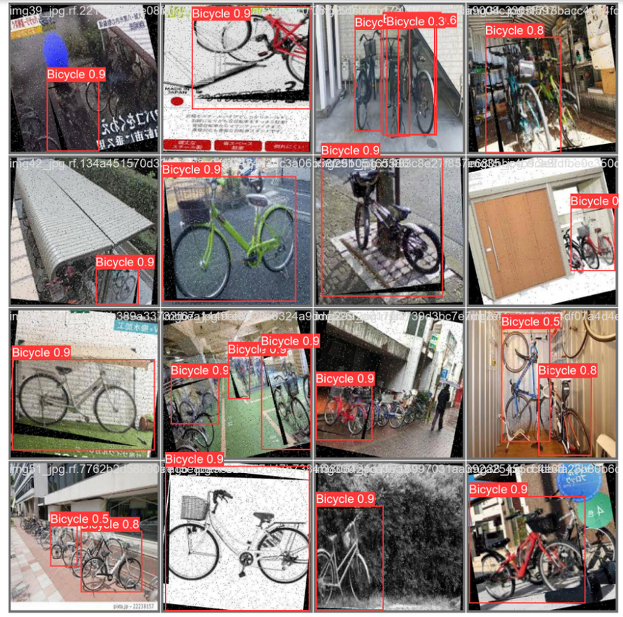
YOLO V8 model - Object Detection Results
Detections across various conditions: clear, cluttered, and challenging environments.
High confidence scores (majority at 0.9), indicating strong model certainty.
Multiple instances per image accurately identified.
Performance in diverse scenarios: inclement weather, varying lighting, and angles.
Occasional overlaps in bounding boxes or partial detections (e.g., images with multiple bicycles).

Slide 15


Task Ownership
Data Collection
Data Processing
Data Training
Summary & Slides
Vijay Devalla
Min-Yun Lai
Blair Chang
Upmanyu Tyagi
Rui Li

Slide 16
Reference
Yolo V8 with Additional Head
https://y-t-g.github.io/tutorials/yolov8n-add-classes/#caveats-and-conclusion
Yolo V8 with custom dataset
https://www.youtube.com/watch?v=wuZtUMEiKWY
Yolo V8 framework
https://www.youtube.com/redirect?https://colab.research.google.com/github/roboflow-ai/notebooks/blob/main/notebooks/train-yolov8-object-detection-on-custom-dataset.ipynb

Slide 17


Thank you
For your attention

